Slide 1
Team 502
NASA Student Launch
Virtual Design Review (VDR) 2

Slide 2
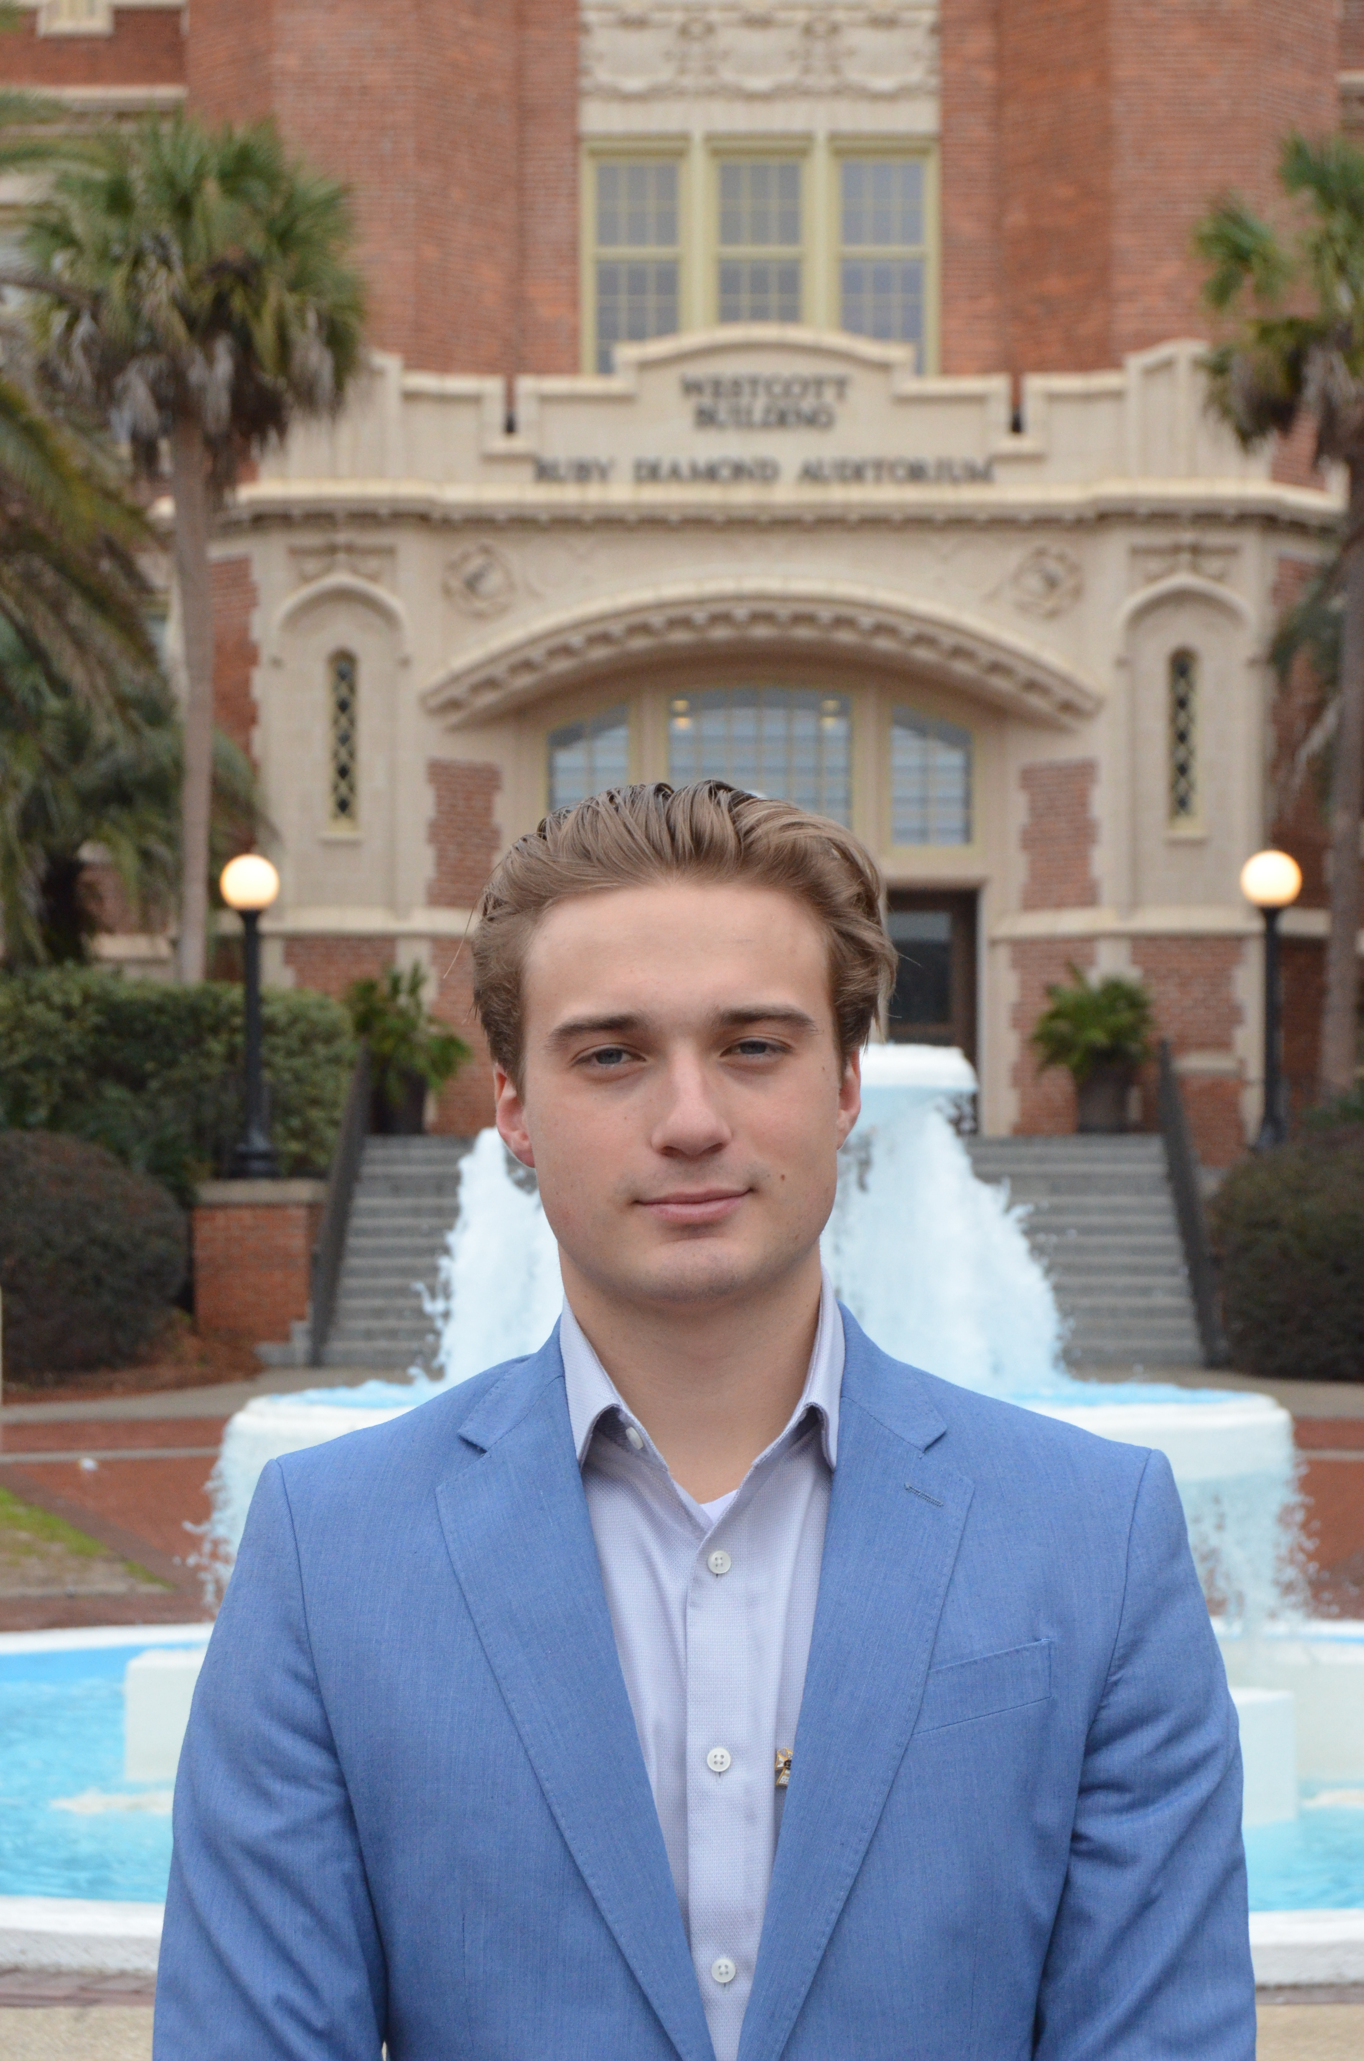

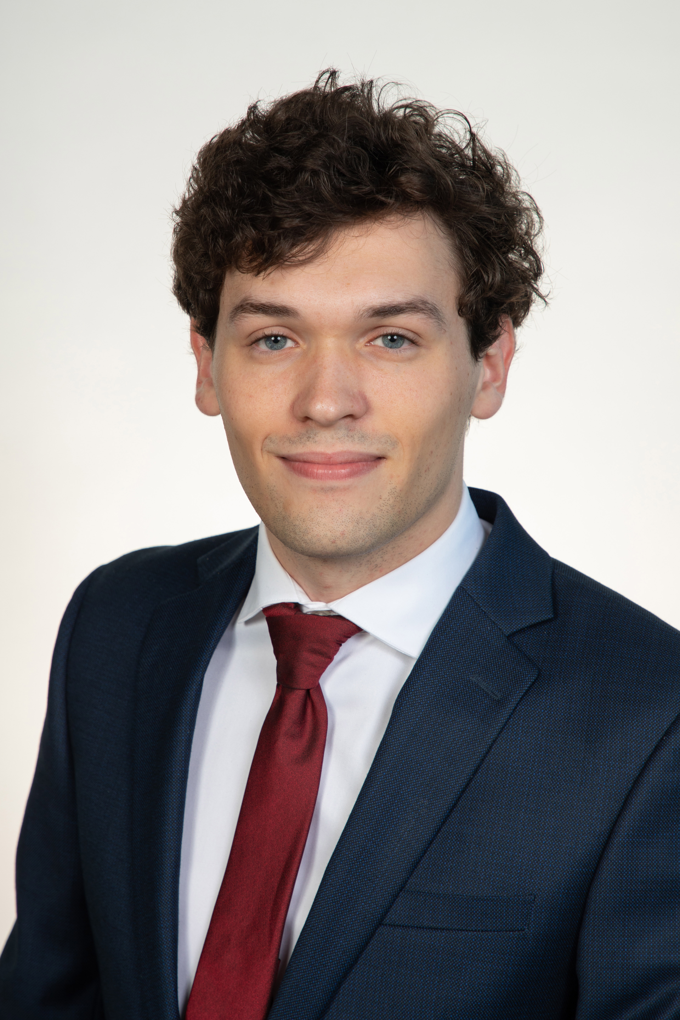
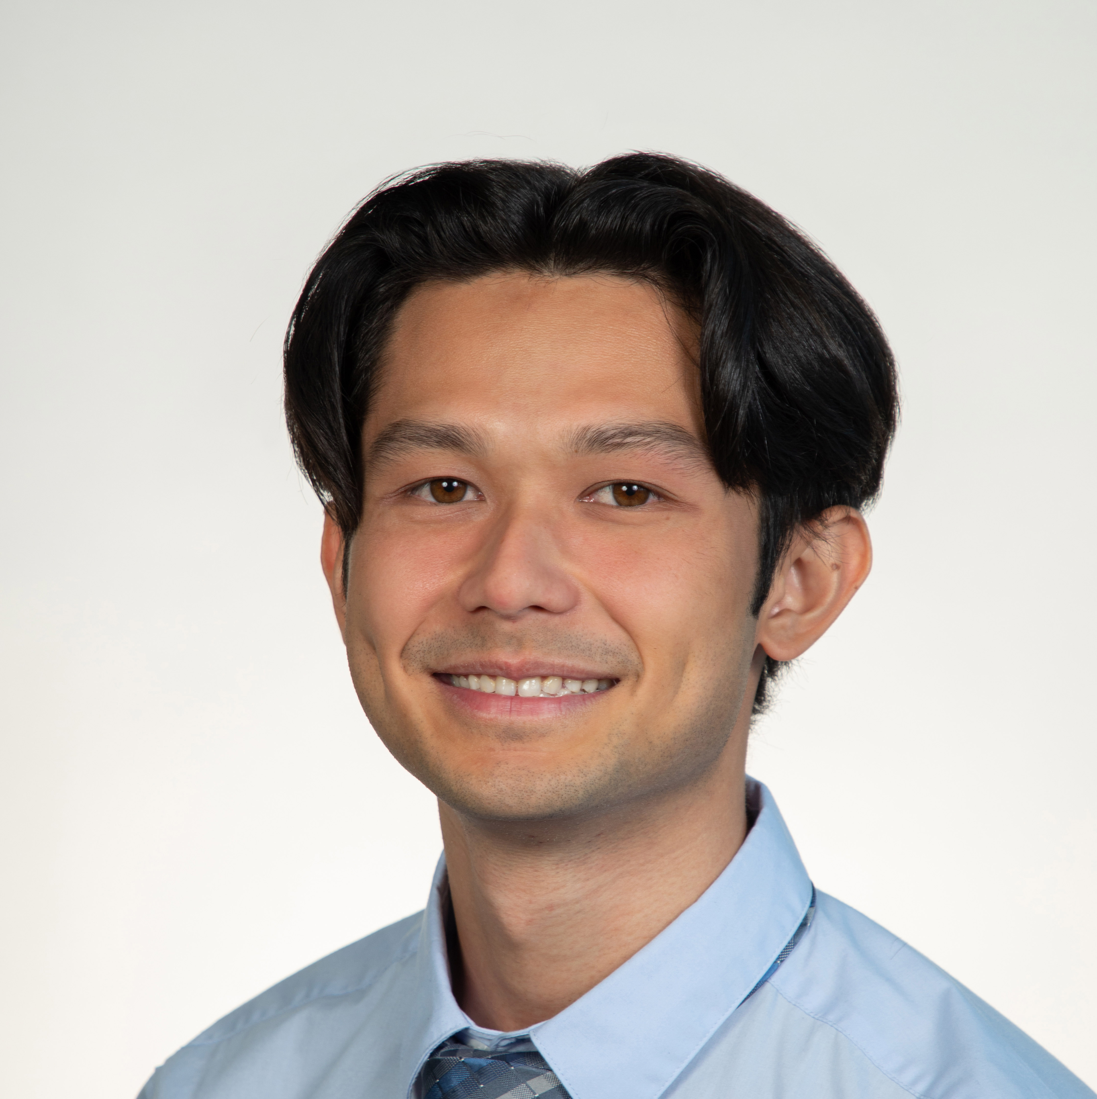

Team Introductions
Everyone
Nicholas Hux
Airframe Design Engineer
Jacob Miller
Avionics/Software
Engineer
Jacob Schmitt
Systems Engineer
Connor Zhou
Controls Engineer
Atzimba Avellaneda
Fabrication Engineer

Slide 3

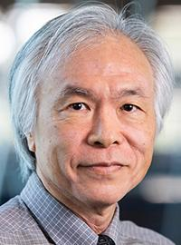
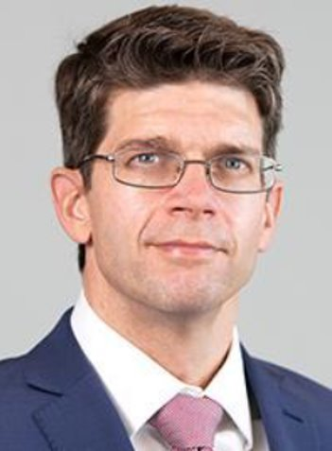
Sponsors and Advisor
Connor Zhou
Sponsor
Shayne McConomy, Ph.D.
Professor
Academic Advisor
Chiang Shih, Ph.D.
Professor
Sponsor
William Oates, Ph.D.
ME Dept. Chair

Slide 4
Objective
Connor Zhou
The objective of this project is to design, fabricate, and fly a high-powered rocket for competition in the 2024 NASA Student Launch. The vehicle will deliver a payload to a specified altitude, deploy it, and then be recovered safely.

Slide 5
Project Background
Connor Zhou
Research-based and competitive challenge that supports NASA Space Launch System and Artemis mission.
Student teams across the U.S. design, build, test, and launch a high-powered rocket with an engineering payload.

Slide 6
Key Goals
Connor Zhou
Demonstrate a successful sub-scale & full-scale flight.
Assemble and launch the vehicle at the official competition in Huntsville, Alabama.
Engage students to interact with STEM activities.
Complete all reports and ensure they are turned in before their due date or on their due date.

Slide 7
Functional Decomposition
Connor Zhou
Rocket
Propulsion
Avionics
Structure
Aerodynamics
Structural integrity
Payload
Deployment
Control
Retention
Propulsion
Detach payload from vehicle
Reduce vibrations
Accelerates vehicle
Sensing
Secure STEMnauts throughout flight
Allow for ingress/egress after landing
Stabilization
Generate thrust
Dissipation
Dissipate kinetic energy during payload descent
Stabilize payload during flight
Land in desired orientation
Minimize kinetic energy upon landing
Recovery
Deploy drogue parachute at apogee
Deploy main parachute at appropriate height
Measure vehicle altitude and velocity
Store flight data
Receive signal
Decelerate vehicle
Generate gravity opposing force
Minimize aerodynamic stresses
Reduce drag forces
Generate force for stage separation
Location tracking
Launch Vehicle
Recieves launch signal
Ignites propellant
Expels matter
Measure location data
Transmit location data
Secures parachutes to vehicle
Recieve deployment signal
Recieve deployment signal
Keep stages together on ascent
Resist Yaw
Resist Pitch

Slide 8
Functional Decomposition
Connor Zhou
Rocket
Propulsion
Avionics
Structure
Aerodynamics
Structural integrity
Reduce vibrations
Accelerates vehicle
Sensing
Generate thrust
Recovery
Deploy drogue parachute at apogee
Deploy main parachute at appropriate height
Measure vehicle altitude and velocity
Store flight data
Minimize aerodynamic stresses
Reduce drag forces
Generate force for stage separation
Location tracking
Launch Vehicle
Recieves launch signal
Ignites propellant
Expels matter
Measure location data
Transmit location data
Secures parachutes to vehicle
Recieve deployment signal
Recieve deployment signal
Keep stages together on ascent
Resist Yaw
Resist Pitch

Slide 9
Functional Decomposition
Connor Zhou
Rocket
Payload
Deployment
Control
Retention
Propulsion
Detach payload from vehicle
Secure STEMnauts throughout flight
Allow for ingress/egress after landing
Stabilization
Dissipation
Dissipate kinetic energy during payload descent
Stabilize payload during flight
Land in desired orientation
Minimize kinetic energy upon landing
Receive signal
Decelerate vehicle
Generate gravity opposing force

Slide 10
Senior Design Deliverable Updates
Connor Zhou
Targets &
Metrics
Concept
Generation
Concept
Selection

Slide 11
Targets & Metrics
Connor Zhou
Function | Target | Metric
Generate thrust. | <5120 Ns | Impulse
Measure vehicle altitude and velocity. | 20 Hz | Frequency
Store flight data. | 1 MB | Memory
Deploy drogue chute. | 1491 m | Altitude
Deploy main chute. | 167 m | Altitude
Minimize aerodynamic stress. | 340 Ma | Yield strength
Reduce drag. | 0.29 | Drag coefficient
Reduce excess vibrations. | 0.8 Ns/m | Coefficient of damping
Detach payload from vehicle. | 120-240 m | Altitude
Secure STEMnauts in payload flight. | 2 mm | Positional margin

Slide 12
Concept Generation
Nick Hux
Biomimicry
Crap Shoot
Forced Analogy
Battle of Perspectives
Morphological Chart

Slide 13
Concept Generation - Medium Fidelity
Nick Hux
Solid propellant motor, ogive nose cone, parabolic tail cone, blue tube structure, dual-stage deployment, and off-the-shelf altimeters for flight control.
Solid propellant motor, a conic nose cone, conic tail cone, an aluminum structure, three-stage deployment, and an assortment of sensors.
Solid propellant motor, parabolic nose cone, parabolic tail cone, Blue Tube body, single-stage deployment, and off-the-shelf altimeter.

Slide 14
Concept Generation - High Fidelity
Nick Hux
Dual deployment rocket with an elliptical nose cone and conic tail cone. Solid propellant motor with G12 fiberglass body structure.
Dual deployment rocket with an Ogive nose cone and parabolic tail cone. Solid propellant motor with G12 fiberglass body structure.
Dual deployment rocket with Haack series nose cone and parabolic tail cone. Solid propellant motor with Blue Tube body structure.

Slide 15
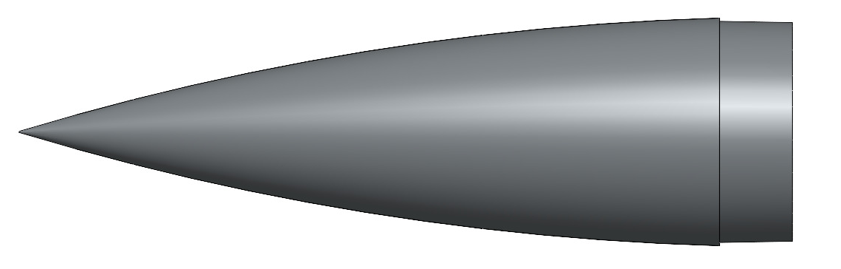
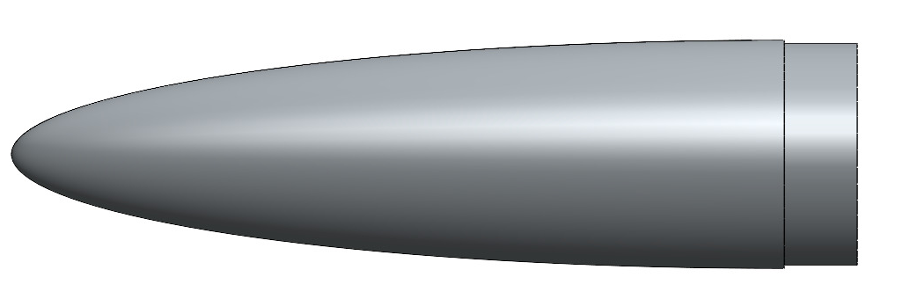
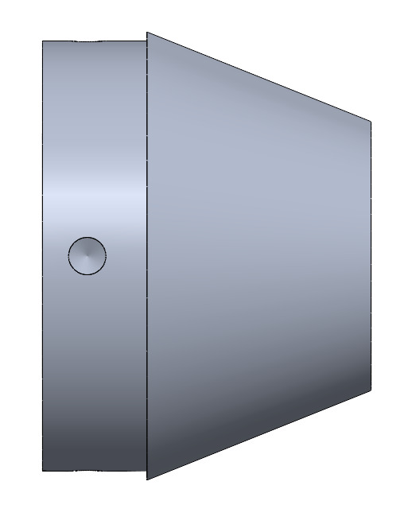
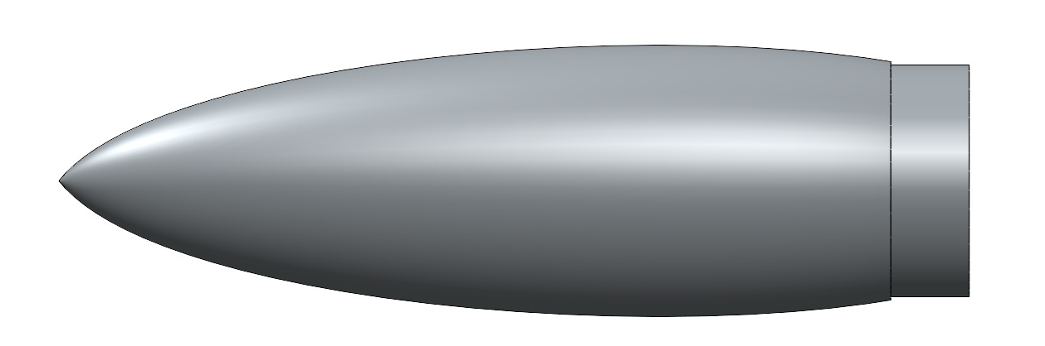
Design Feature Pictures
Ogive Nosecone
Elliptical Nosecone
Haack Series Nosecone
Conical Tailcone

Slide 16
Concept Selection
Nick Hux
Pairwise Comparison
House of Quality
Pugh Chart
Analytical Hierarchy

Slide 17
Pairwise Comparison Output
Nick Hux
Customer Needs | IWF | Customer Needs | IWF
Can withstand flight stresses. | 16 | Prioritize aspects neglected in previous years. | 9
Has correct licenses and permits. | 13 | Payload deploys between 400ft - 800ft. | 9
Can track and store flight data. | 13 | Vehicle reaches specified altitude. | 6
Minimizes danger to surroundings. | 12 | STEMnauts land safely without parachute. | 6
Vehicle/Payload recovered safely. | 12 | Detailed design reports are submitted. | 5
NRA/TRA certified ascent. | 11 | Landing velocity of < 25 ft/s. | 4
All components function intentionally. | 11 | Mass distribution tracked. | 2
Operates up to 5280ft altitude. | 10 | Materials and parts tracked. | 2
Trackable after flight. | 10 | No size requirements. | 2
Customer Needs
Comparison
Importance Weight Factor

Slide 18
House of Quality Output
Nick Hux
Engineering Characteristics to Pugh Chart
Measure vehicle altitude and velocity.
Generate thrust.
Deploy drogue parachute.
Deploy main parachute.
Minimize aerodynamic stress.
Secure STEMnauts in payload flight.
Customer Needs
Engineering Characteristics

Slide 19
Pugh Chart Outputs
Nick Hux
Concepts
2 stage powered ascent.
Concepts – Pugh 1
Blue Tube body, Ogive features.
Concepts – Pugh 2
Blue Tube body, Ogive features.
Aluminum body, conic features.
Blue Tube body, Ogive features.
Blue Tube body, parabolic features,
Fiberglass body, elliptical features.
Blue Tube and ASA body, Haack series features.
Fiberglass and PETG body, Ogive features.
Blue Tube body, parabolic features.
Hollowed out components.
Blue Tube and ASA body, Haack series features.
Fiberglass and PETG body, Ogive features.
Blue Tube body, parabolic features.
Fiberglass and PETG body, Ogive features.
Hollowed out components.

Slide 20
AHP Output
Jake Miller
Criteria Weights
Design Alternate Priority
Alternate Value
Final Selection

Slide 21
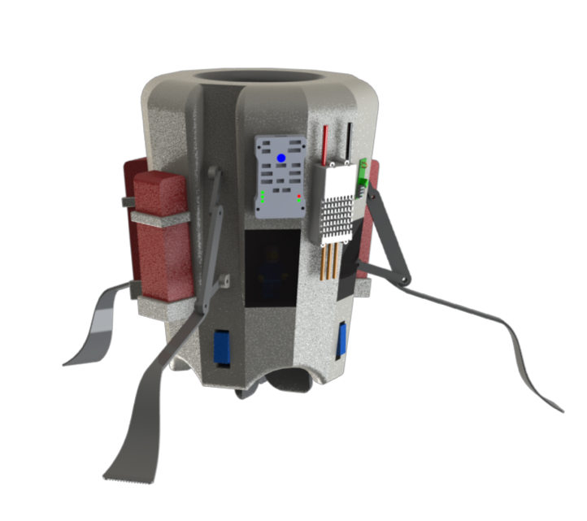
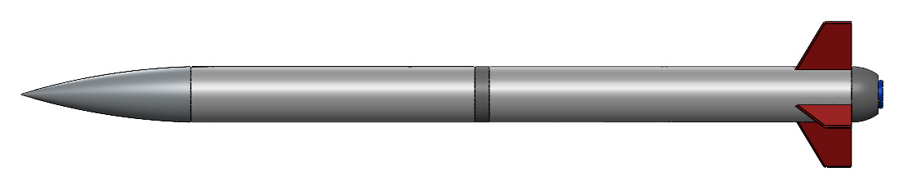
Concept Selection
Jake Miller
Rocket
The selected vehicle concept is a dual-deployment design.
L class solid propellant motor.
G12 fiberglass body with ASA 3D-printed parabolic tail cone and Ogive nose cone.
Payload
Thrust-vectoring monocopter design.
Servo-actuated fins to control descent.

Slide 22
NASA Deliverable Updates
Jake Miller
Preliminary Design Review.
Sub-scale vehicle.
Critical Design Review.

Slide 23
Preliminary Design Review (PDR)
Jake Miller
PDR report, presentation, and flysheet were completed and turned in on October 26th.
PDR was presented to NASA on November 15th.

Slide 24
Sub-scale Vehicle Overview
Jake Miller
Parts, Fabrication, and Testing
Bill of materials finalized for subscale vehicle, recovery, and avionics.
Parts sent to Pro Hruda and are currently arriving.
Fabrication and testing with Zenith team has begun.
Flight Schedule
Subscale flight scheduled December 9th.
Backup subscale flight date set for December 16^{th.}
Successful subscale flight deadline January 8th.

Slide 25
Sub-scale Vehicle Design
Jake Miller
Airframe
G12 fiberglass body material.
PETG 3D-printed Ogive nose cone.
PETG 3D-printed parabolic tail cone.
Recovery
Dual deployment stage separation.
Separation achieved with black powder and CO2.
Avionics
Off-the-shelf AIM3 and TeleMetrum altimeters.

Slide 26
Critical Design Review (CDR)
Jake Miller
CDR report, presentation, and flysheet due on January 8th.
Contains sub-scale flight data analysis, iteration on payload, and full-scale vehicles.

Slide 27
Future Work
Jake Miller
Payload fabrication, testing, and iteration.
Sub-scale launch and possible backup launch.
Spring Project Plan.
Full-scale fabrication and test launches.
Critical Design Review (CDR).
Flight Readiness Review (FRR).
Team Semester Review.

Slide 28
Questions?
Thank you!

Slide 29
Backup Slides

Slide 31
This is 10-point
This is 15–point Times
This is 20–point
This is 25–point
This is 30–point
This is 35–point
This is 40–point
This is 50–point
This is 60–point
This is 72–point
Notes:
Use at least 20-point font in Room A105, B134, and B136
Use at least 25-point font in Room B135

Slide 32
College of Engineering Color Palette
1 2 3 4
Pantone: PMS 195 C
RGB: 120, 47, 64
Hex: #782F40
CMYK:19, 90, 50, 55
1 2 3 4
Pantone: Black C
RGB: 0, 0, 0
Hex: #000000
CMYK:0, 0, 0, 100
Garnet
Black
1 2 3 4
RGB: 238, 118, 36
Hex: #EE7624
CMYK:2, 66, 99, 0
1 2 3 4
Pantone: PMS 000C
RGB: 255, 255, 255
Hex: #FFFFFF
CMYK: 0, 0, 0, 0
Fang
Orange
White
Notes:
Avoid 75% Black in B135

Slide 33
Accent Color Palette
1 2 3 4
RGB: 0, 59, 111
Hex: #003B6F
CMYK:
1 2 3 4
RGB: 0, 59, 111
Hex: #003B6F
CMYK:
1 2 3 4
RGB: 251, 236, 93
Hex: #FBEC5D
CMYK:
1 2 3 4
RGB: 219, 215, 210
Hex: #DBD7D2
CMYK:
1 2 3 4
RGB: 251, 236, 93
Hex: #FBEC5D
CMYK:
1 2 3 4
RGB: 219, 215, 210
Hex: #DBD7D2
CMYK:
Tardis Blue
Tardis Blue
Corn
Timberwolf
Corn
Timberwolf
1 2 3 4
RGB: 206, 0, 88
Hex: #CE0058
CMYK: 0, 100, 43, 12
1 2 3 4
RGB: 206, 0, 88
Hex: #CE0058
CMYK: 0, 100, 43, 12
1 2 3 4
RGB: 104, 40, 96
Hex: #682860
CMYK:
1 2 3 4
RGB: 220, 220, 220
Hex: #DCDCDC
CMYK:
Rubine Red
Rubine Red
Imperial
Gainsboro
1 2 3 4
RGB: 72, 146, 155
Hex: #48929b
CMYK:
1 2 3 4
RGB: 64, 224, 208
Hex: #40E0D0
CMYK:
1 2 3 4
RGB: 255, 139, 0
Hex: #FF8B00
CMYK:
Asagi-iro
Turquoise
American Orange
Notes:
Remove American orange add hyperlink grey
Make corn the last for b135
All work in 134 imperial move later
Tardis doesn’t work in b136

Slide 34
F7AB19
D67F15
EE7624
D64615
F73119
Analogous
https://color.adobe.com/create/color-wheel
6E3610
F0A16C
EE7624
6E4931
BASB1C
Monochromatic
A14508
4BED3B
EE7624
250CED
2010A1
Triad
A1470C
FF8C40
EE7624
0098A1
24E2ED
Complementary
28A164
2FED8D
EE7624
0848A1
1871ED
Split Complementary
EDAC2F
3BED93
EE7624
0C6AED
ED2F18
Double Split Complementary
ED660C
C7ED3B
EE7624
0CE1ED
A418ED
Square
BA7E09
87724A
EE7624
60EFCF
09BA61
Compound
AD551A
6E3610
EE7624
FA7625
D46820
Shades
Notes:
These are the variants that work well with Fang Orange. The bolded items show well on the projectors.

Slide 35
85412D
8F3831
782f40
8F3176
792D85
Analogous
https://color.adobe.com/create/color-wheel
C44D69
8E626D
782F40
C48796
451B25
Monochromatic
C43959
78743B
782F40
236178
43A2C4
Triad
C43959
C46078
782F40
25C43D
2F783A
Complementary
93C460
577835
782F40
39C49D
297861
Split Complementary
784435
5A783B
782F40
237860
6E2978
Double Split Complementary
782337
78683b
782F40
237830
293978
Square
AB4D32
DEBAAF
782F40
5D8555
70AB32
Compound
38161E
C44D69
782F40
853447
5E2532
Shades

Slide 36
A105
A105
B135 Stage Left
B135 Stage Right
B136
B134, A105
B135

